Slide 1
CSE 6040/x Programming Skills Office Hours
Week 6, Session 1

Slide 2
Agenda for This Week
Session 1
Preview of topics for Module 2, Topics 7-11
Introduction to Pandas, key concepts
Topic 7: Notes on Pandas, part 0
Only 1 session this week, because of MT1

Slide 3
Module 2 Preview – From course syllabus
Topic 7: Tidying data (All about Pandas and tidy data)
Pandas, merge/join, tibbles and bits, melting and casting
Topic 8: Visualizing data and results (Not tested)
Seaborn, Bokeh
Topic 9: Relational data (SQL)
Topic 10: Intro to numerical computing
NumPy / SciPy
Topic 11: Ranking relational objects
Graphs as (sparse) matrices, PageRank
Applications of Pandas and Numerical Computing

Slide 4
Python Libraries
A Python library is simply a collection of codes that we can use in a program for specific operations.
We use libraries so that we don’t need to write the code again in our program that is already available.
Python Standard Library
Example – collections, dict(), range(), set(), list() etc.
Other Libraries (Third party libraries)
There are several other libraries written by people around the world that make a programmer’s life easier
Example – pandas, matplotlib, numpy
Advantages :
Save Time - you do not need to develop the functionality that the library provides
Use Pre-Tested Code - A popular library will have been used in multiple environments and use cases.

Slide 5
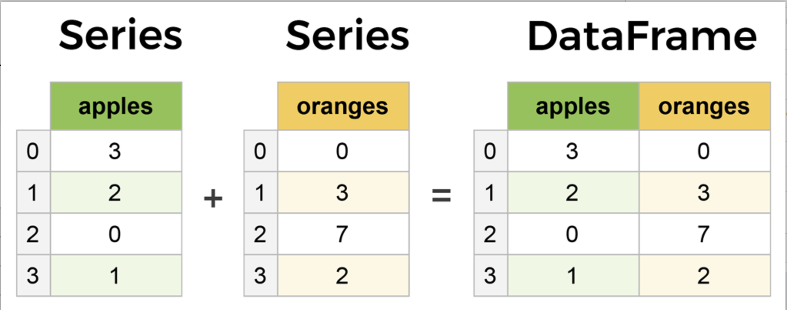
Intro to Pandas – Series and DataFrames
A Series is essentially a column, and a DataFrame is a multi-dimensional table made up of a collection of Series.
A Series differs from a Python list in that the types of its elements are assumed to be the same. Doing so allows many operations on a Series to be faster than their counterparts for list objects. Example in the notebook
This doesn’t mean you can’t have different types of elements in a Series. But if you have a series having elements of only one data types, some operations will be faster

Slide 6
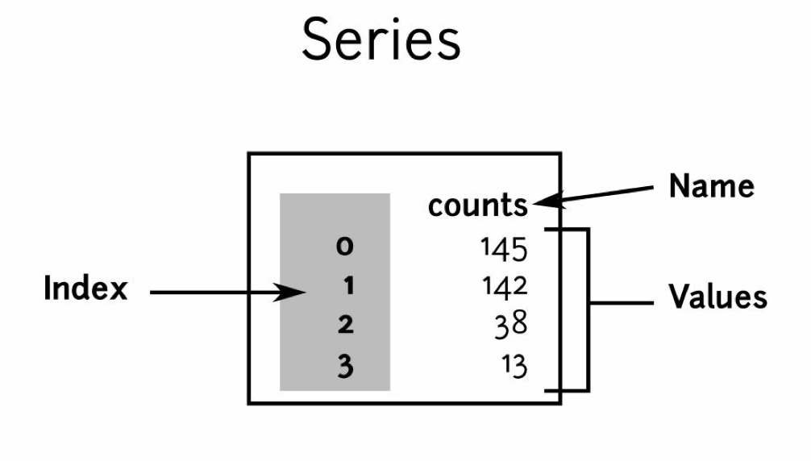
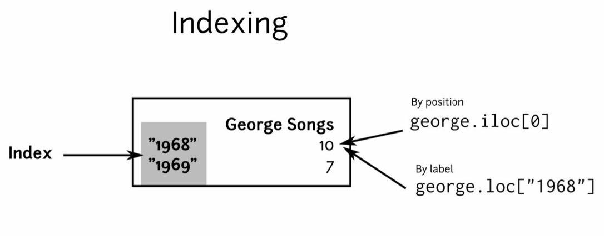
More on Series
You can access all these three elements using: counts.name
counts.index
counts.values
Index need not be integer, it can be a string as well
Few points to keep in mind –
Basic arithmetic operations work like “vector-operations” or “element-wise” operations – meaning they are applied to each element
Using comparison operators (>,<,>=,== etc) returns a series with boolean values and can be used to filter an existing Series
in checks if an index is present in the Series, whereas series.isin() checks if an element is present in the values of the Series

Slide 7
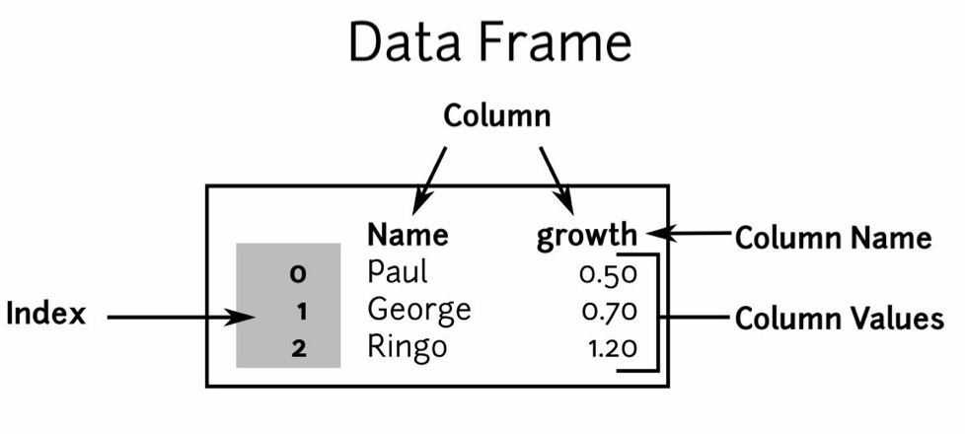
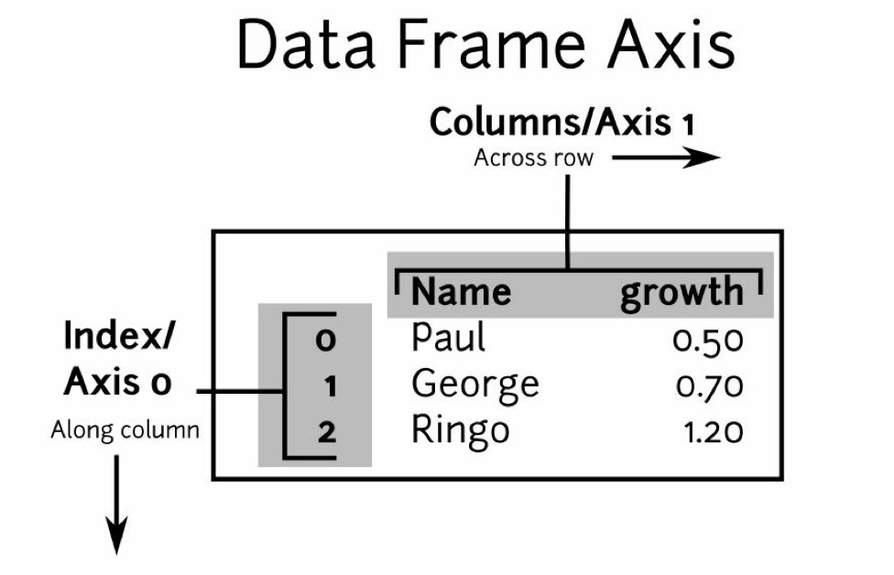
Pandas DataFrame
A pandas DataFrame object is a table whose columns are Series objects, all keyed on the same index. It's the perfect container for tabular data.
This is a GREAT article* on different ways to create a dataframe.
*There are instances in which you have a python data structure (list of lists , dictionary etc.) and you might need to create a dataframe. Being aware of different ways to create a dataframe from these data structures can make your analysis quicker

Slide 8
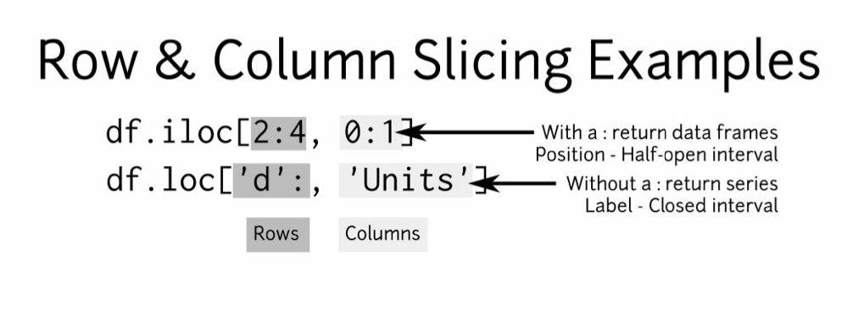
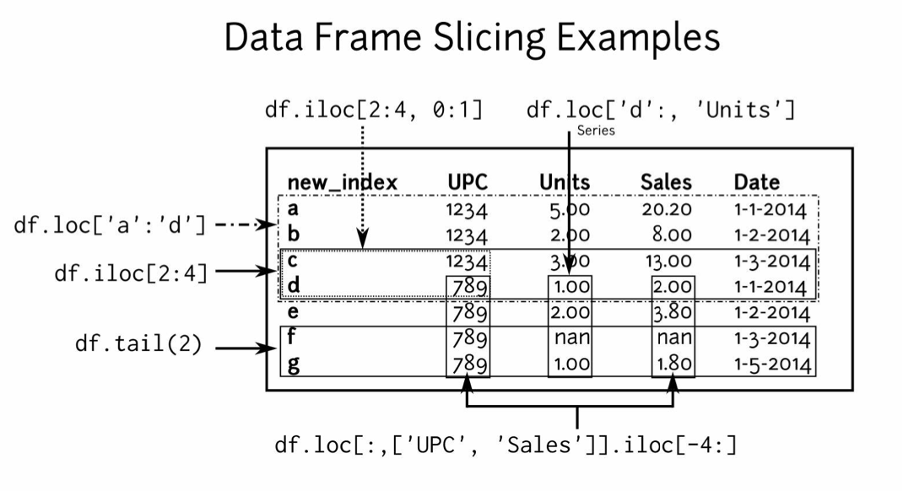
DataFrame Slicing
Using DataFrame slicing operations, you can get the data you need for further analysis
Keep in mind the .loc and .iloc syntax and the difference between the two. Look at the example on the right to see the difference

Slide 9
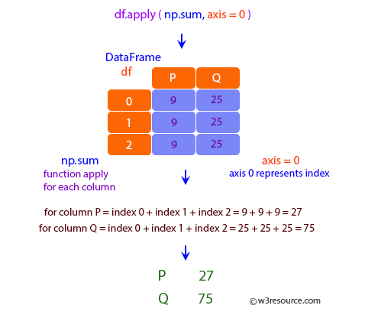
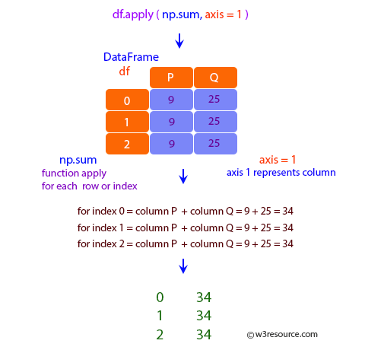
apply() function - DataFrame
Since dataframe is composed of multiple series, .apply() for dataframes has an axis parameter as well
Source - this notebook on w3resource

Slide 10
Open Discussion / Q&A

